Slide 1

WeChat
Rachel Guo

Slide 2

What is it?
Multi- purpose messaging, social media and mobile payment app
Developed by Tencent
IOS, macOS, Androids, Windows
Released in 2011
Became one of the world’s largest standalone mobile apps in 2018
Over 1 billion monthly active users

Slide 3

Features
Messaging
Official Accounts
Moments
WeChat Pay (digital payment services)
Enterprise WeChat
Mini Program

Slide 4


Slide 5
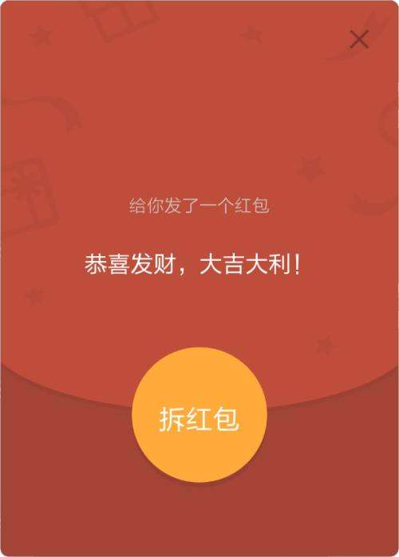
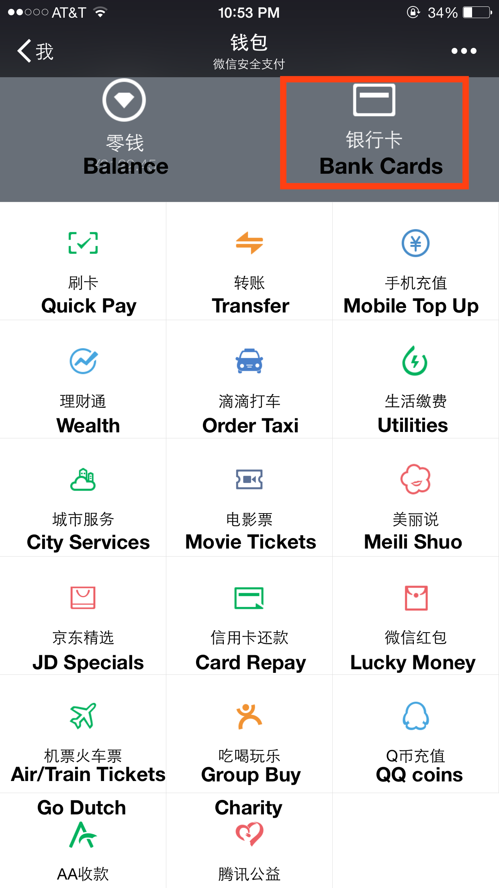


Slide 6

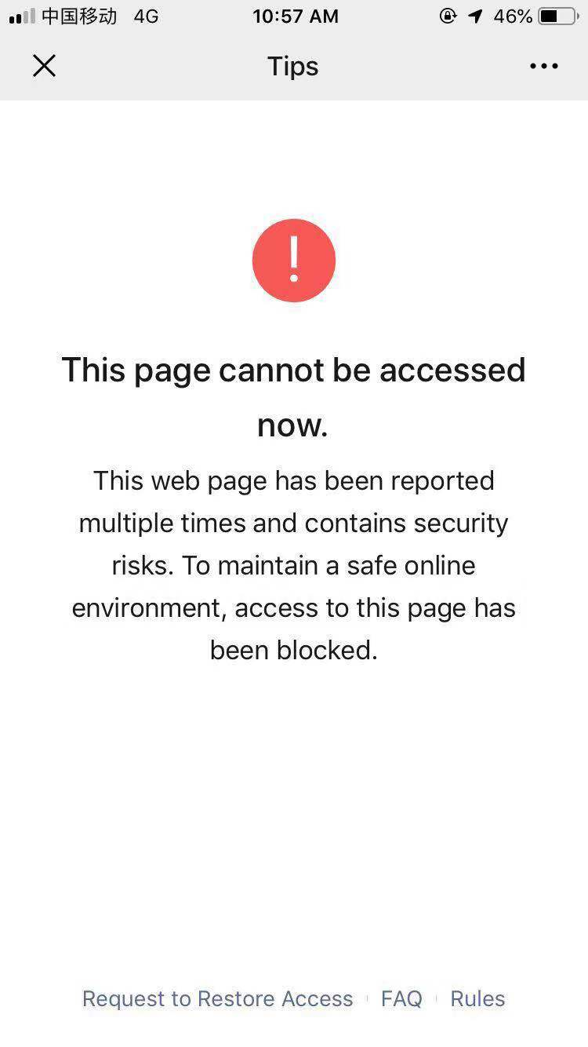
Censorship

Slide 7
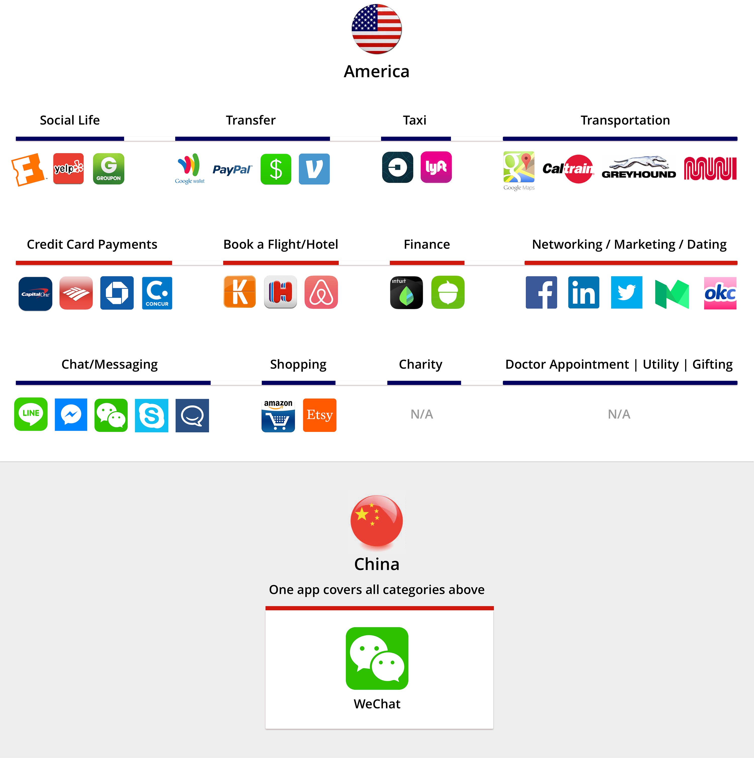
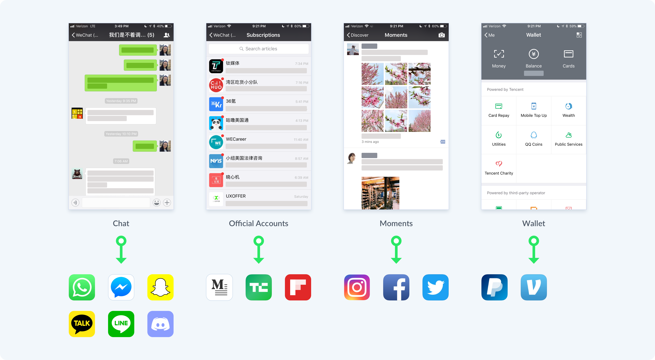

Slide 8
